Slide 1
Chapter 3. Control structures
Branching statement – simple if, else-if, nested-if, elseif-ladder,switch case, goto statement.
Looping – while, do-while, for.

Slide 2
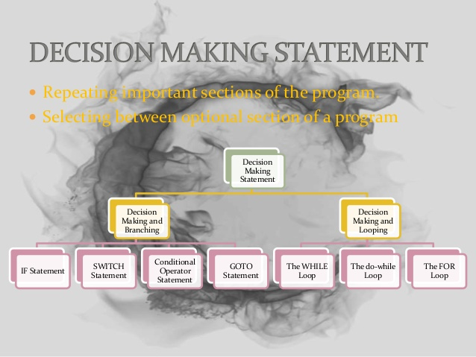

Slide 3
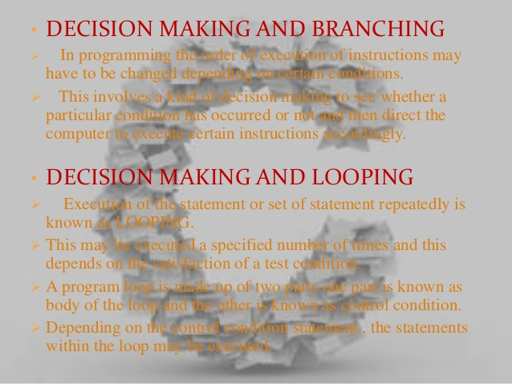

Slide 4
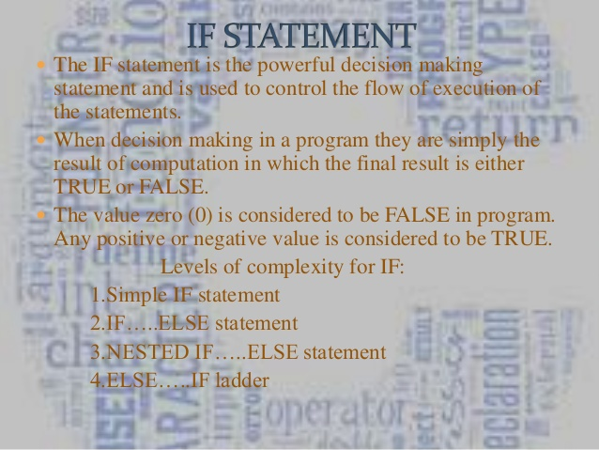

Slide 5
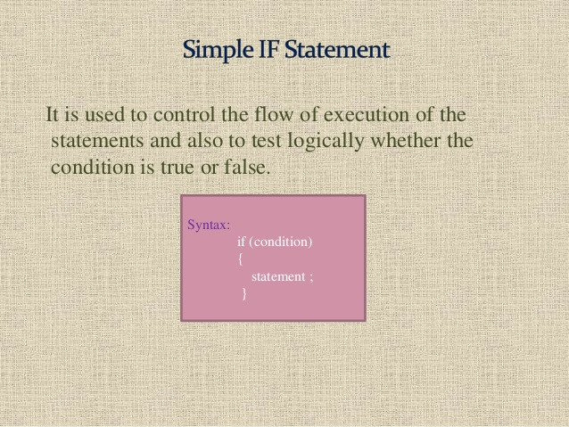

Slide 6
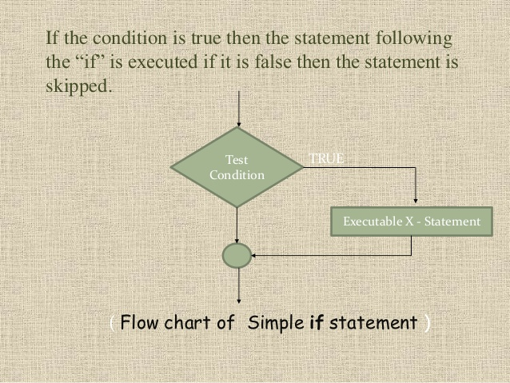

Slide 7
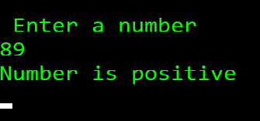
/* Simple if example
write a program to find if number is positive */
#include<stdio.h>
#include<conio.h>
void main()
{
int number;
printf("\n Enter a number");
scanf("%d",&number);
if(number>0)
{
printf("Number is positive \n");
}
getch();
}
Output :

Slide 8
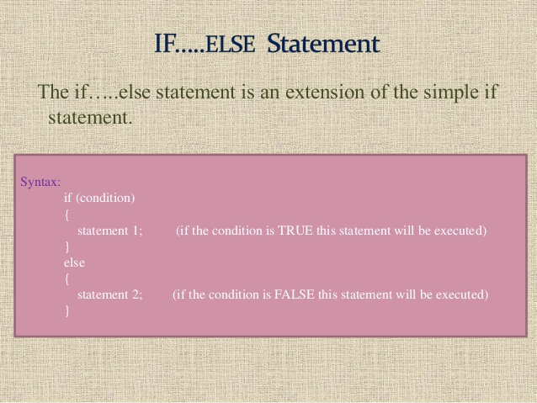

Slide 9
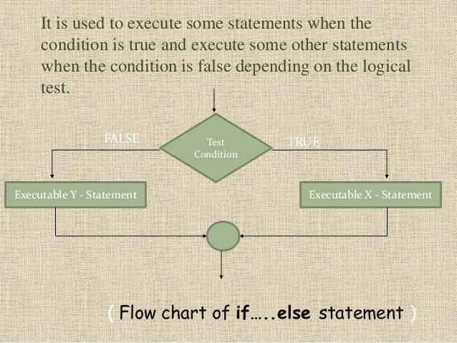

Slide 10
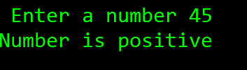
/* write a program to find if number is positive */
#include<stdio.h>
#include<conio.h>
void main()
{
int number;
printf("\n Enter a number");
scanf("%d", &number);
if(number>0)
{
printf("Number is positive \n");
}
else
{
printf("Number is negative \n");
}
getch();
}
Output :

Slide 11
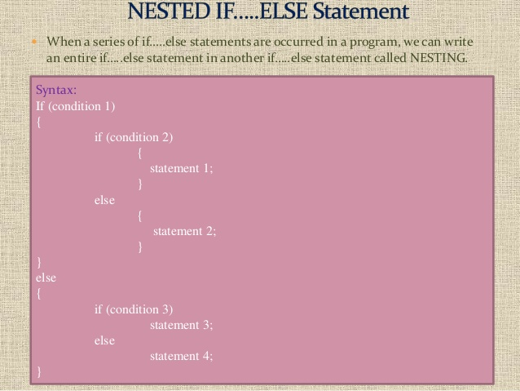

Slide 12
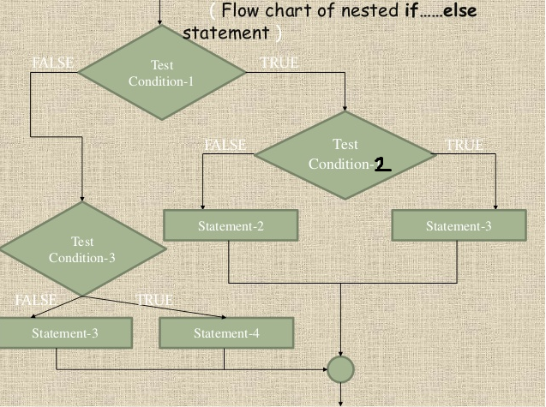

Slide 13
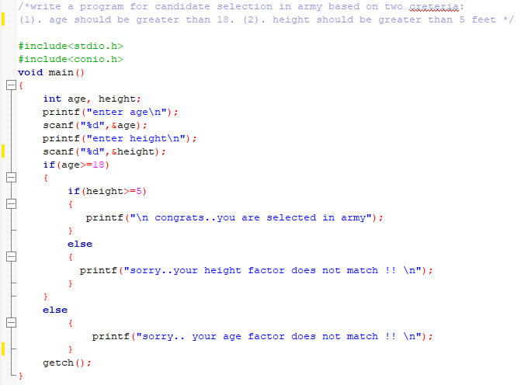
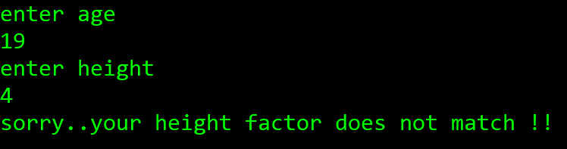
Output :

Slide 14
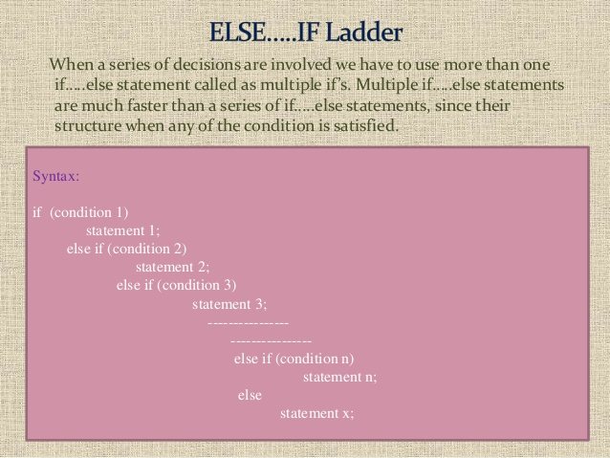

Slide 15
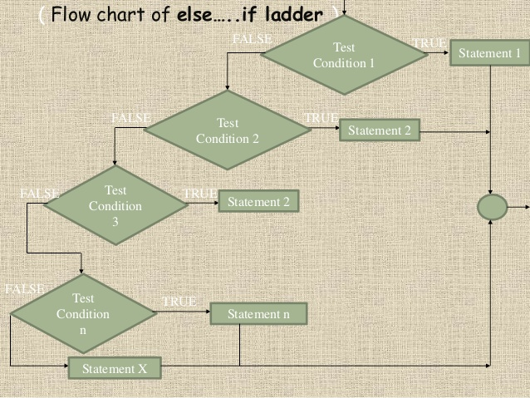

Slide 16
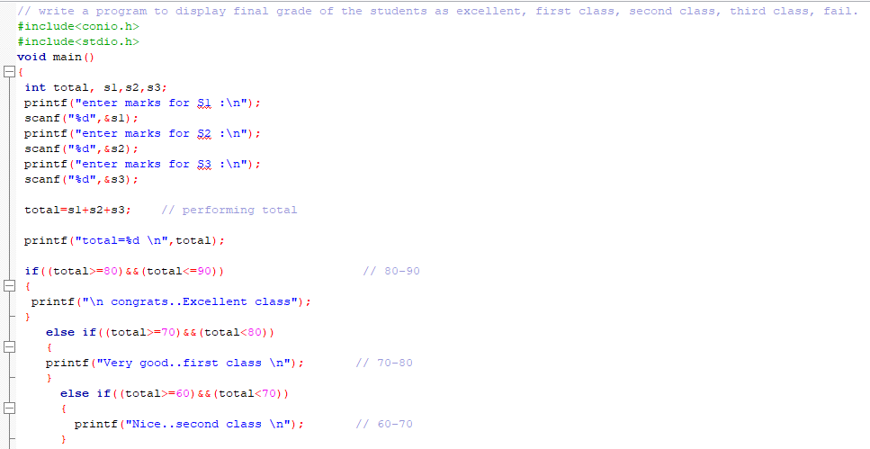
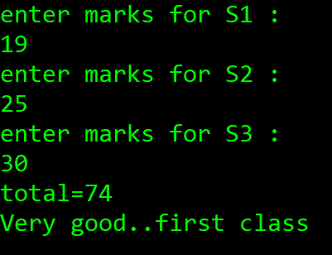
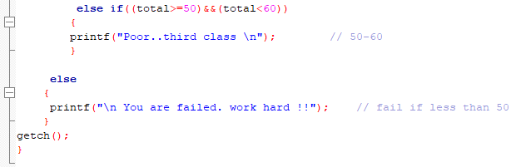
Output :

Slide 17
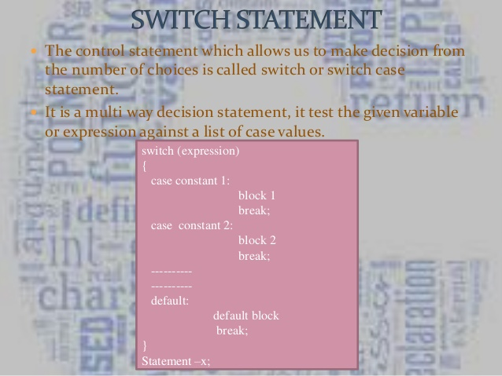

Slide 18
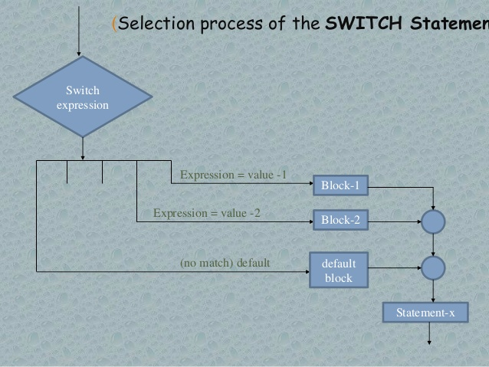

Slide 19
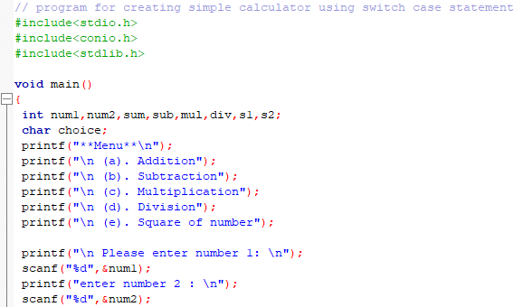
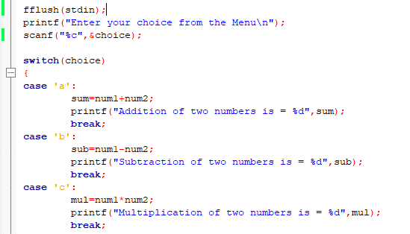
Continue….
On next slide

Slide 20
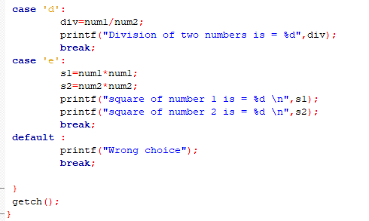
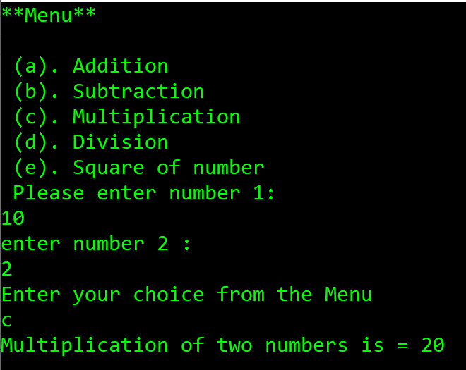
Output :

Slide 21
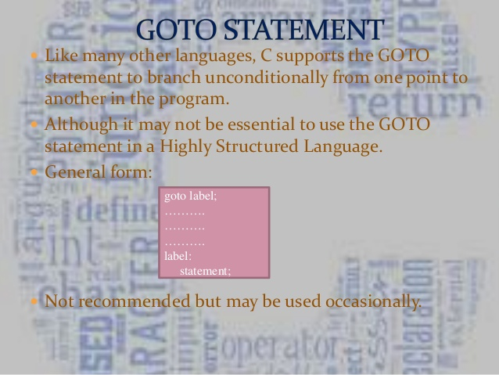

Slide 22
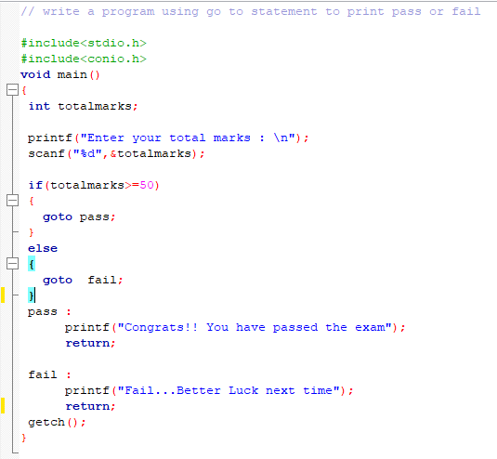
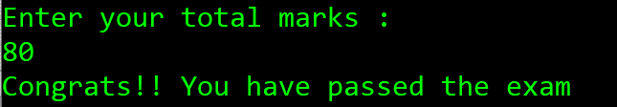
Output :

Slide 23
END

